Slide 1
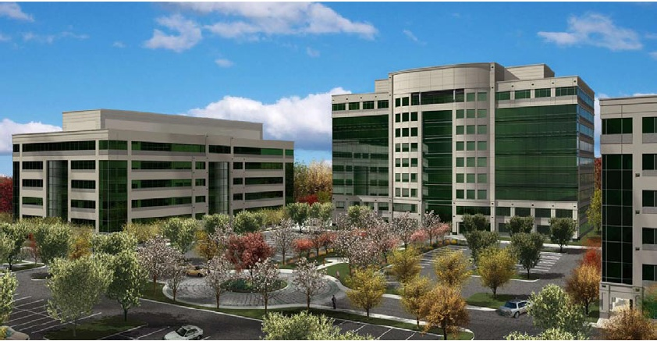
Redland Tech Center
Rockville, MD

Slide 2
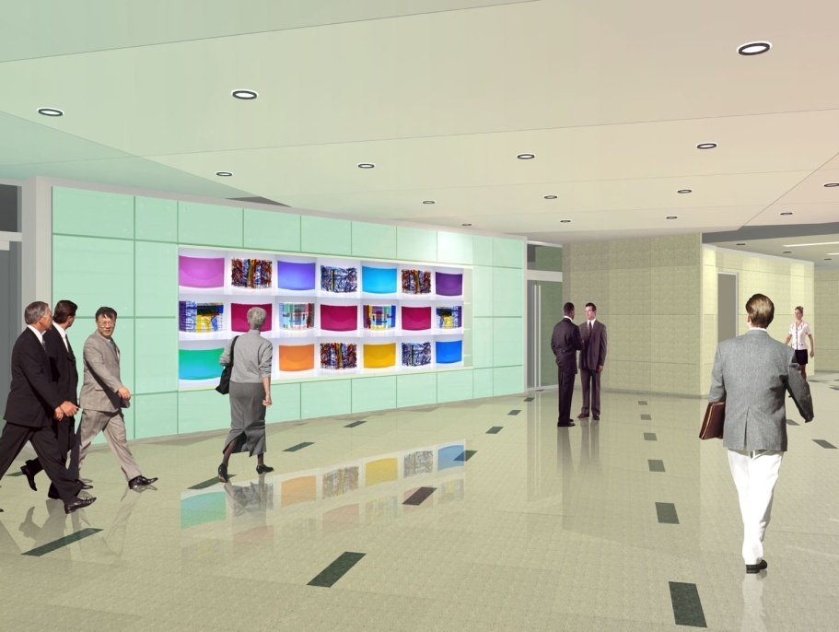
Presentation Outline
Project Overview
Chilled Beam HVAC System (MAE) (Mechanical)
NEC Wire Sizing (Electrical)
Parking Garage Sequencing
Conclusion and Recommendations
Questions and Acknowledgements

Slide 3
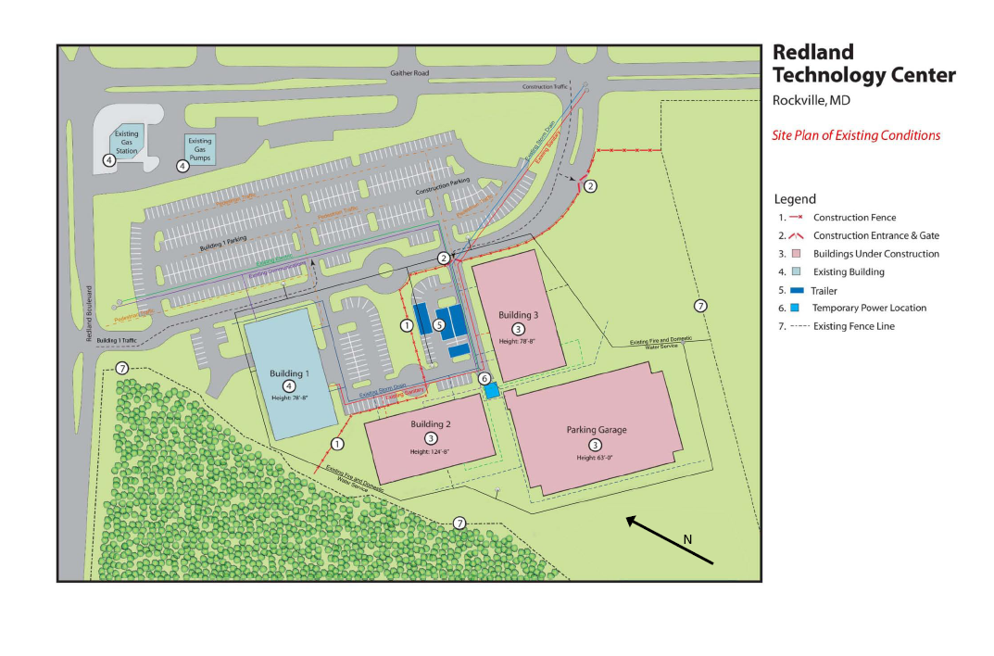
Project Overview
Two office buildings with stand alone parking garage
Building II: 9 levels; 210,240 SF
Building III: 6 levels; 136,430 SF
Parking Garage: 6 levels; 310,600 SF
January 2008 – June 2009 Construction
$52,800,000 Negotiated GMP
Design-Bid-Build

Slide 4
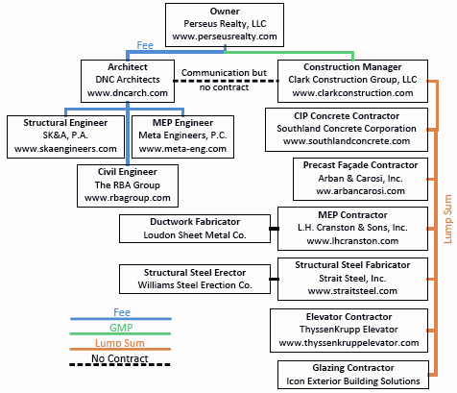
Project Overview
Structural steel office buildings
Precast façade with curtain wall and ribbon windows
Self-contained air conditioning units with VAVs
Precast parking garage
LEED Silver Certification

Slide 5
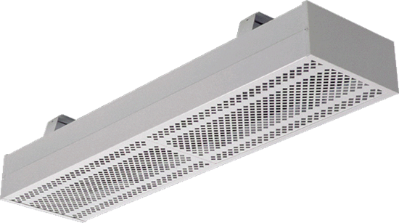
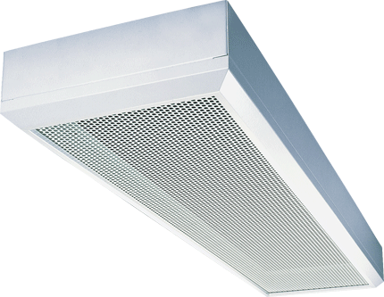
Critical Industry Research: Chilled Beams
Energy efficiency becoming more important
Water more efficient energy transporter
Reduce ductwork, fans, AHUs, VAVs, plenum space
Increase piping, pumping
Two types: Passive and Active
Used in Europe and Australia for several decades
Notes:
1” diameter water pipe can transport the same cooling energy as an 18” square duct
Energy costs much higher in Europe

Slide 6
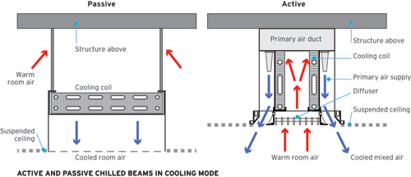
Passive Chilled Beams
Use natural convection to cool air
Only provide sensible cooling
Cannot be used for heating
Requires separate system for latent loads and ventilation
200-650BTUH sensible heat per ft of beam
Exposed or recessed type
Notes:
Typically coupled with under floor air distribution system

Slide 7
Active Chilled Beams
Forced air induction
Primary air and secondary cooling
Used for cooling and heating
1,100 BTUH sensible heat per ft of beam
Typically used with dedicated outdoor air system (DOAS)
Several varieties to suit building requirements
Notes:
Heating by four pipe system to chilled beams or electric coil at each chilled beam to reheat primary air
50-70% of sensible load extracted by the secondary cooling
They come in different lengths and widths, different nozzle types to affect the induction rate, and one, two or even four way discharge patterns.

Slide 8
Multi-service Chilled Beams
Prefabricated unit
Incorporates other building systems
Both passive and active types
Notes:
Lighting fixtures and controls, speakers, occupancy sensors, smoke detectors, and even fire sprinklers can be incorporated into the beam

Slide 9
Chilled Beam Advantages
Reduce primary air by 75-85%
20-40% savings in energy consumption
Reduced ductwork size
Low maintenance
Increased room comfort; quiet
Payback less than 5 years typical
Notes:
Classroom building at MIT reduced energy consumption by 40% with chilled beams
Laboratory at the University of North Carolina cut energy consumption by 20%
ASHRAE figure demonstrates typical power savings with chilled beam systems versus a conventional all air system
Reduce ductwork by 50%, reduce AHUs, eliminate VAVs, reduce floor-to-floor height
Maintenance every 4-5 years

Slide 10
Chilled Beam Disadvantages
Initial cost higher
Not familiar in United States
Cannot be used in areas with high or unpredictable humidity levels
Notes:
Industry professional stated it should only cost 5-15% more
Has seen 30% premium for chilled beams on early projects; engineers, contractors and vendors adding contingencies for unfamiliarity
Certain types of developers not willing to pay higher initial costs; unable to lease out for more money; best for college campuses and government buildings where they building and operate buildings and can take advantage of payback period
Can’t be used in areas such as lobby entrances, kitchens, exercise rooms, and pool areas; because of condensation on cooling coil

Slide 11
Chilled Beam Applications
Best for projects with high sensible loads
Retrofit and renovation projects
Projects with building heightt restrictions
Projects with ultimate sustainability goals
Notes:
Computer labs, laboratories
Chilled beams can reduce plenum space potentially by 2-3’ per floor

Slide 12
Chilled Beams at RTC Building II
Analysis uses active chilled beams
Used chilled beams only in open office space
Maximized energy efficiency by matching primary air to ventilation air requirements
Analysis assumptions:
  100 ft²/person
  Current design used 72⁰F room air, 55⁰F supply air
  Latent load = 200 BTUH/person
Notes:
Multi-service beams adds complexity to analysis that is unnecessary to determine feasibility of chilled beams as an alternative HVAC system
Lobby, exercise room, café, corridors, and bathrooms will not be changed
Exercise room and café have own separate HVAC systems
ASHRAE Standard 62.1-2007 – Ventilation for Acceptable Indoor Air Quality

Slide 13
Chilled Beams at RTC Building II
Analysis uses active chilled beams
Used chilled beams only in open office space
Maximized energy efficiency by matching primary air to ventilation air requirements
Analysis assumptions:
  100 ft²/person
  Current design used 72⁰F room air, 55⁰F supply air
  Latent load = 200 BTUH/person
Floor | Description | Area (SF) | Population | VAV CFM | Sensible Load (BTUH) | Latent Load (BTUH) | Outdoor Air Requirement (CFM)
1 | Open Office | 11,380 | 114 | 9,500 | 174,420 | 22,760 | 1,565
2 | Open Office | 19,862 | 199 | 12,000 | 220,320 | 39,724 | 2,731
3 | Open Office | 20,534 | 205 | 12,000 | 220,320 | 41,068 | 2,823
4 | Open Office | 20,534 | 205 | 12,000 | 220,320 | 41,068 | 2,823
5 | Open Office | 20,534 | 205 | 12,000 | 220,320 | 41,068 | 2,823
6 | Open Office | 20,534 | 205 | 12,000 | 220,320 | 41,068 | 2,823
7 | Open Office | 20,534 | 205 | 12,000 | 220,320 | 41,068 | 2,823
8 | Open Office | 20,534 | 205 | 12,000 | 220,320 | 41,068 | 2,823
9 | Open Office | 20,534 | 205 | 12,000 | 220,320 | 41,068 | 2,823
Notes:
Using these assumptions and ASHRAE 62.1-2007, calculated loads and outdoor air requirements
77% on average reduction in primary air

Slide 14
Number of Chilled Beams Required
Room air: 72⁰F/50% relative humidity (0.00836lb_{w}/lb_{da})
Supply air: 55⁰F/58% relative humidity (0.00535lb_{w}/lb_{da})
Analysis used 1,000 BTUH sensible heat per ft of beam
Based on 6’ chilled beams
Notes:
All of latent load and ventilation requirements handled by the primary air
Calculated humidity ratio of 0.00535 lbw/lbda = 37.45 grains
Some portion of sensible load capacity handled by the primary air
Calculated the primary air sensible capacity to determine the required secondary cooling sensible capacity
Use this to calculate the # of chilled beams required

Slide 15
Number of Chilled Beams Required
Room air: 72⁰F/50% relative humidity (0.00836lb_{w}/lb_{da})
Supply air: 55⁰F/58% relative humidity (0.00535lb_{w}/lb_{da})
Analysis used 1,000 BTUH sensible heat per ft of beam
Based on 6’ chilled beams
Floor | Total Sensible Load (BTUH) | Primary Air Sensible Capacity (BTUH) | Primary Air Sensible % of Total | Secondary Sensible Capacity (BTUH) | Secondary Sensible % of Total
1 | 174,420 | 28,729 | 16.5% | 145,691 | 83.5%
2 | 220,320 | 50,142 | 22.8% | 170,178 | 77.2%
3 | 220,320 | 51,838 | 23.5% | 168,482 | 76.5%
4 | 220,320 | 51,838 | 23.5% | 168,482 | 76.5%
5 | 220,320 | 51,838 | 23.5% | 168,482 | 76.5%
6 | 220,320 | 51,838 | 23.5% | 168,482 | 76.5%
7 | 220,320 | 51,838 | 23.5% | 168,482 | 76.5%
8 | 220,320 | 51,838 | 23.5% | 168,482 | 76.5%
9 | 220,320 | 51,838 | 23.5% | 168,482 | 76.5%
Notes:
All of latent load and ventilation requirements handled by the primary air
Calculated humidity ratio of 0.00535 lbw/lbda = 37.45 grains
Some portion of sensible load capacity handled by the primary air
Calculated the primary air sensible capacity to determine the required secondary cooling sensible capacity
Use this to calculate the # of chilled beams required

Slide 16
Number of Chilled Beams Required
Room air: 72⁰F/50% relative humidity (0.00836lb_{w}/lb_{da})
Supply air: 55⁰F/58% relative humidity (0.00535lb_{w}/lb_{da})
Analysis used 1,000 BTUH sensible heat per ft of beam
Based on 6’ chilled beams
Floor | Secondary Sensible Capacity (BTUH) | Linear Feet of Chilled Beam Required | Number of 6' Chilled Beams
1 | 145,691 | 146 | 25
2 | 170,178 | 170 | 29
3 | 168,482 | 168 | 29
4 | 168,482 | 168 | 29
5 | 168,482 | 168 | 29
6 | 168,482 | 168 | 29
7 | 168,482 | 168 | 29
8 | 168,482 | 168 | 29
9 | 168,482 | 168 | 29
 |  | Total Number of 6’ Beams | 257
Notes:
All of latent load and ventilation requirements handled by the primary air
Calculated humidity ratio of 0.00535 lbw/lbda = 37.45 grains
Some portion of sensible load capacity handled by the primary air
Calculated the primary air sensible capacity to determine the required secondary cooling sensible capacity
Use this to calculate the # of chilled beams required

Slide 17
Chilled Beam Costs
Material cost for chilled beams is $140 per linear foot
Material cost for chilled beams is $140 per linear foot
Each 6’ beam will cost $1,680 installed
Floor | Number of 6' Chilled Beams | Material Cost | Labor Cost | Total Cost
1 | 25 | $21,000 | $21,000 | $42,000
2 | 29 | $24,360 | $24,360 | $48,720
3 | 29 | $24,360 | $24,360 | $48,720
4 | 29 | $24,360 | $24,360 | $48,720
5 | 29 | $24,360 | $24,360 | $48,720
6 | 29 | $24,360 | $24,360 | $48,720
7 | 29 | $24,360 | $24,360 | $48,720
8 | 29 | $24,360 | $24,360 | $48,720
9 | 29 | $24,360 | $24,360 | $48,720
 |  | Total Chilled Beam Cost |  | $431,760
 |  | Chilled Beam Cost per SF |  | $2.47

Slide 18
Description | Material | Labor | Total | % of Total
Chilled Water Piping | $116,601 | $66,159 | $182,760 | 7.6%
Mechanical Insulation | $58,998 | $76,002 | $135,000 | 5.6%
Pumps | $20,004 | $3,558 | $23,562 | 1.0%
Cooling Towers | $205,775 | $16,325 | $222,100 | 9.2%
VAVs | $37,088 | $8,212 | $45,300 | 1.9%
Fans | $79,100 | $7,413 | $86,513 | 3.6%
Self Contained AHUs | $790,242 | $38,183 | $828,425 | 34.5%
Ductwork | $97,290 | $607,710 | $705,000 | 29.3%
Controls | $86,670 | $48,330 | $135,000 | 5.6%
Condensate Piping | $9,412 | $13,488 | $22,900 | 1.0%
Testing and Balancing | $0 | $18,000 | $18,000 | 0.7%
Totals | $1,501,178 | $903,382 | $2,404,560 | 100.0%
VAV Mechanical System Cost per SF = $11.44

Slide 19
Chilled Beam Component Costs
Chilled water piping
  Material: $8.94/lf *1,300lf/floor*9floors = $104,598
  Labor: $5.06/lf *1,300lf/floor*9floors = $59,202
  Total Additional Cost: $163,800
Mechanical Insulation
  No change
Pumps
  Material: $20,004*2 = $40,008
  Labor: $3,558*2 = $7,116
  Total Additional Cost: $47,124
Cooling Tower
  No change
Notes:
No change because less insulation for ductwork but more for chilled water piping. Estimated as a wash.
Cooling towers have no change because the cooling loads have remained the same

Slide 20
Chilled Beam Component Costs
VAVs
  Material: 72VAVs*$442/VAV = $31,824
  Labor: 72VAVs*$442/VAV = $31,824
  Total Savings: $38,808
Fans
  Material: 0.7*0.92*$79,100 = $50,940
  Labor: 0.7*0.92*$7,413 = $4,774
  Total Savings: $55,714
SCUs
  Material: $790,242
  Labor: $38,183
  Total Savings: $828,425
Electric Heating Coils
  Material: 257coils*$620/coil = $159,340
  Labor: 257coils*$59/coil = $15,163
  Total Additional Cost: $174,503
Notes:
Switching to chilled beams has many additional components required. In the original SCU system, each unit had its own compressor and heating coil. With the removal of the SCUs, need to add heating coils for localized reheat of primary air at the chilled beams, wiring for the heating coils, centrifugal chillers, and AHUs to provide the primary outdoor air.

Slide 21
Chilled Beam Component Costs
Wiring and Conduit for Heating Coils
  Material: 3-wires*$0.81/LF*650LF/floor*9floors = $14,217
  Labor: $2.47/LF*650LF/floor*9floors = $14,450
  Total Additional Cost: $28,667
Centrifugal Chillers
  Material: $384,160
  Labor: $384,160
  Total Additional Cost: $402,192
AHUs
  Material: $46,592
  Labor: $7,056
  Total Additional Cost: $53,648
Ductwork
  Material: 0.45*0.92*$97,290 = $40,278
  Labor: 0.25*0.92*$607,710 = $137,773
  Total Savings: $178,051
Notes:
Original building had 870-tons of cooling required. Added 900-ton chiller for chilled beam system
Added 15,000 CFM and 20,000 CFM AHU to handle primary air
Total CFM reduced by 70%. Corresponds to 45% reduction in amount of ductwork material needed

Slide 22
Chilled Beam Component Costs
Controls
  Material: 0.92*$86,670 = $79,736
  Labor: 0.92*$48,330 = $44,464
  Total Savings: $124,200
Condensate Piping
  No change
Testing and Balancing
  Material: $0
  Labor: $124,200
  Total Savings: $16,560

Slide 23
Description | Material | Labor | Total | % of Total
Chilled Beams | $215,880 | $215,880 | $431,760 | 17.4%
Chilled Water Piping | $221,199 | $125,361 | $346,560 | 14.0%
Mechanical Insulation | $58,998 | $76,002 | $135,000 | 5.4%
Pumps | $60,012 | $10,674 | $70,686 | 2.9%
Cooling Towers | $205,775 | $16,325 | $222,100 | 9.0%
VAVs | $5,264 | $1,228 | $6,492 | 0.3%
Fans | $28,160 | $2,639 | $30,799 | 1.2%
Self Contained AHUs | $0 | $0 | $0 | 0.0%
Electric Heating Coils | $159,340 | $15,163 | $174,503 | 7.0%
Wiring and Conduit for Heating Coils | $14,217 | $14,450 | $28,667 | 1.2%
Centrifugal Chiller | $384,160 | $18,032 | $402,192 | 16.2%
AHUs | $46,592 | $7,056 | $53,648 | 2.2%
Ductwork | $57,012 | $469,937 | $526,949 | 21.3%
Controls | $6,934 | $3,866 | $10,800 | 0.4%
Condensate Piping | $9,412 | $13,488 | $22,900 | 0.9%
Testing and Balancing | $0 | $16,560 | $16,560 | 0.7%
Totals | $1,472,954 | $1,006,662 | $2,479,616 | 100%
Chilled Beam Mechanical System Cost per SF = $11.79

Slide 24
Description | Material | Labor | Total | % of Total
Chilled Beams | $215,880 | $215,880 | $431,760 | 17.4%
Chilled Water Piping | $221,199 | $125,361 | $346,560 | 14.0%
Mechanical Insulation | $58,998 | $76,002 | $135,000 | 5.4%
Pumps | $60,012 | $10,674 | $70,686 | 2.9%
Cooling Towers | $205,775 | $16,325 | $222,100 | 9.0%
VAVs | $5,264 | $1,228 | $6,492 | 0.3%
Fans | $28,160 | $2,639 | $30,799 | 1.2%
Self Contained AHUs | $0 | $0 | $0 | 0.0%
Electric Heating Coils | $159,340 | $15,163 | $174,503 | 7.0%
Wiring and Conduit for Heating Coils | $14,217 | $14,450 | $28,667 | 1.2%
Centrifugal Chiller | $384,160 | $18,032 | $402,192 | 16.2%
AHUs | $46,592 | $7,056 | $53,648 | 2.2%
Ductwork | $57,012 | $469,937 | $526,949 | 21.3%
Controls | $6,934 | $3,866 | $10,800 | 0.4%
Condensate Piping | $9,412 | $13,488 | $22,900 | 0.9%
Testing and Balancing | $0 | $16,560 | $16,560 | 0.7%
Totals | $1,472,954 | $1,006,662 | $2,479,616 | 100%
Chilled Beam Mechanical System Cost per SF = $11.79
VAV Cost | Chilled Beam Cost | Cost Increase | % Increase
$2,404,560 | $2,479,616 | $75,056 | 1.03

Slide 25
Additional Office Space w/ Chilled Beams
Removed SCUs add office space for floors 2-7
360SF/floor
2,160SF additional office space
Office space will lease for $12/SF/month
Additional leasing income of $25,290/month

Slide 26
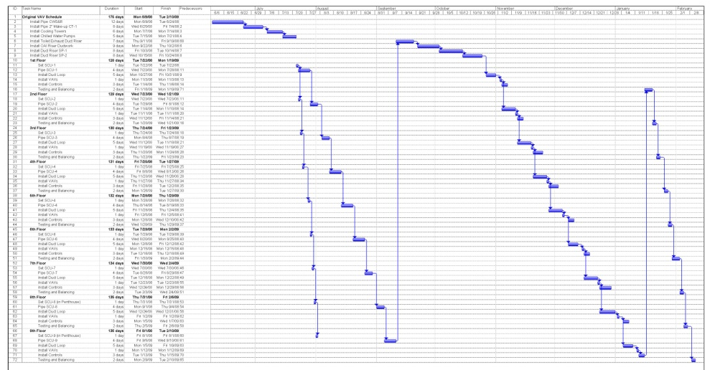
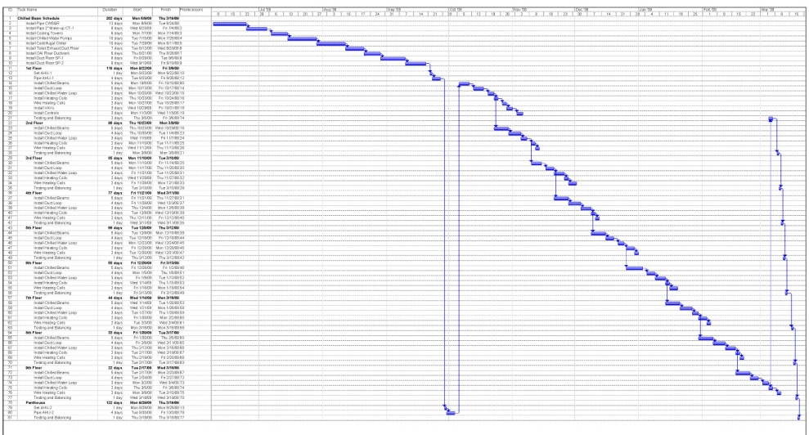
Chilled Beam Schedule Impacts
Original Schedule:
  June 9, 2009 – February 10, 2009
  246 days
Chilled Beam Schedule:
  June 9, 2009 – March 19, 2009
  283 days
Overall Project Schedule:
  No change
Original VAV Schedule
Chilled Beam Schedule
Notes:
Chilled beam duration went up because there is so many more components to install on each floor. Water piping, more chilled beams (29 versus 8 VAVs), heating coil and wiring, more chilled water piping. Extra time is spent in the open area office space where it will not slow other trades. Core and shell project, no finishes to work around

Slide 27
Energy Savings
EPA estimates annual HVAC energy cost/SF for Mid-Atlantic area office building to be $1.59/SF
Annual HAVC Cost = $1.59/SF*210,240SF = $334,282 per year

Slide 28
Energy Savings
EPA estimates annual HVAC energy cost/SF for Mid-Atlantic area office building to be $1.59/SF
Annual HAVC Cost = $1.59/SF*210,240SF = $334,282 per year
Energy Reduction | HVAC Energy Costs per Year | Savings per Year
20% | $267,426 | $66,856
30% | $233,997 | $100,285
40% | $200,569 | $133,713

Slide 29
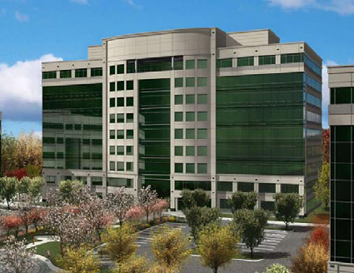
Payback Period
Additional cost of $75,056 (1.03% increase)
Savings between $66,856 and $133,713 in energy costs
Additional $311,040/year in office leasing revenue
Less than 1 year payback

Slide 30
Conclusion
Initial cost increase of $75,056 (1.03%)
VAV system cost = $2,404,560 = $11.44/SF
Chilled beam system cost = $2,479,616 = $11.79/SF
Lower operating costs, higher revenues offset higher initial cost with less than 1 year payback
Chilled beams increased HVAC construction duration by 37 days
Overall project schedule not affected
Chilled beams unfamiliar to industry professionals in United States
Recommendation
Chilled beams should be pursued on more projects in US
Would be appropriate to use for RTC project

Slide 31
NEC Wire Sizing
Upsizing wire conductors has the potential to the improve the energy efficiency of buildings
Wire conductors have resistance which creates voltage drops and uses energy
Larger conductors have lower resistance than smaller wires
Analysis determines the feasibility of upsizing wires one size larger than NEC code minimum to reduce energy usage

Slide 32
Calculations
Circuit No. 12 on lighting panel LP-H
Powers 2’x4’ parabolic troffer luminaires
277V
Connected load = 4,400 VA
2-#12 AWG - #12 Ground
Luminaires are approximately 100’ from panelboard

Slide 33
Calculations
Current in wires = 4,400VA/277V = 15.9 amps
The first step is to calculate the resistance of #12 wire:
  For #12 THHN @ 75⁰C (From NEC Chapter 9, Table 9):
  R = 2Ω/kFT
  To correct resistance to 30⁰C, use NEC Table 8 footnote:
  R₂ = 2 [1+0.00323(30-75)] = 1.71 Ω/kFT
The second step is to calculate the power loss for #12 wire:
Power Loss = I²*R = (15.9)² * 1.71 * 0.1 = 43.0 W
The third step is to calculate energy loss per year for #12 wire:
Energy Loss = 43.0 W / 1000W/kW * 12hrs/day * 365days/year = 188 kWh/yr
Repeat steps for #10wire

Slide 34
Calculations
Resistance of #10 wire:
  For #10 THHN @ 75⁰C (From NEC Chapter 9, Table 9):
  R = 1.2Ω/kFT
  To correct resistance to 30⁰C, use NEC Table 8 footnote:
  R₂ = 1.2 [1+0.00323(30-75)] = 1.03 Ω/kFT
Power loss for #10 wire:
Power Loss = I²*R = (15.9)² * 1.03 * 0.1 = 26.0 W
Energy loss per year for #10 wire:
Energy Loss = 26.0 W / 1000W/kW * 12hrs/day * 365days/year = 113 kWh/yr
Savings due to upsizing wire:
    188-113 = 75 kWh/yr
Dollar savings at $0.09 per kWh:
    $6.75/yr
Dollar savings at $0.09 per kWh:
    $6.75/yr
Initial cost increase:
    Cost of #12 wire and conduit = $2.85LF*100’ = $285
    Cost of #10 wire and conduit = $3.03LF*100’ = $303
    Cost difference = $18

Slide 35
Discounted Payback Period
Assume MARR = 15%
Period | Cash Flow | Cost of Funds (15%) | Cumulative Cash Flow
0 | ($18) | $0 | ($18)
1 | $6.75 | ($2.70) | ($13.95)
2 | $6.75 | ($2.09) | ($9.29)
3 | $6.75 | ($1.39) | ($3.93)
4 | $6.75 | ($0.59) | $2.23
$0.09/kWh – 4 year payback
Period | Cash Flow | Cost of Funds (15%) | Cumulative Cash Flow
0 | ($18) | $0 | ($18)
1 | $10.50 | ($2.70) | ($10.20)
2 | $10.50 | ($1.53) | ($1.23)
3 | $10.50 | ($0.18) | $9.09
$0.14/kWh – 3 year payback

Slide 36
Other Findings
Payback shows wire upsizing is feasible
Most circuits do not operate at design
Penn State Campus buildings design capacities typically 3 to 4 times average load
Wires already upsized several times

Slide 37
Possible Uses of Wire Upsizing
Locations with constant high loads
Data center equipment
Large constant speed motors
HVAC chillers

Slide 38
Conclusion
Wire upsizing feasible
Savings not drastic
Payback typically within a few years
Best uses would be areas with constant high loads
Data center equipment, large constant speed motors, HVAC chillers
Recommendation
Apply principle only in areas of building projects with high constant loads

Slide 39
Actual Construction Sequence
February 6, 2008 – April 1, 2009; 420 days
Constructed in 2 phases
46 day gap in precast member erection
Notes:
Started erecting members in north end of garage and worked south
Had crane in basement of garage
This was done because close proximity to other buildings and the sedimentation pond; also because of the heavy members it would have been cost prohibitive to use a crane that set all the members from outside the building perimeter
Foundation had to fully cure before members were allowed to be set

Slide 40
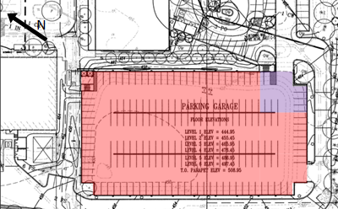
Actual Construction Sequence
February 6, 2008 – April 1, 2009; 420 days
Constructed in 2 phases
46 day gap in precast member erection
Notes:
Started erecting members in north end of garage and worked south
Had crane in basement of garage
This was done because close proximity to other buildings and the sedimentation pond; also because of the heavy members it would have been cost prohibitive to use a crane that set all the members from outside the building perimeter
Foundation had to fully cure before members were allowed to be set

Slide 41
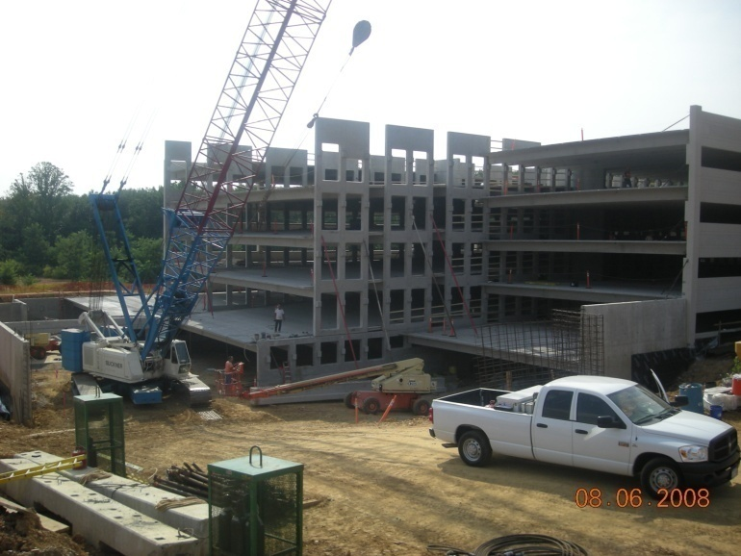
Actual Construction Sequence
February 6, 2008 – April 1, 2009; 420 days
Constructed in 2 phases
46 day gap in precast member erection
Notes:
Started erecting members in north end of garage and worked south
Had crane in basement of garage
This was done because close proximity to other buildings and the sedimentation pond; also because of the heavy members it would have been cost prohibitive to use a crane that set all the members from outside the building perimeter
Part of delay was to build remaining part of foundation, but part of it was because the foundation had to fully cure before members were allowed to be set

Slide 42
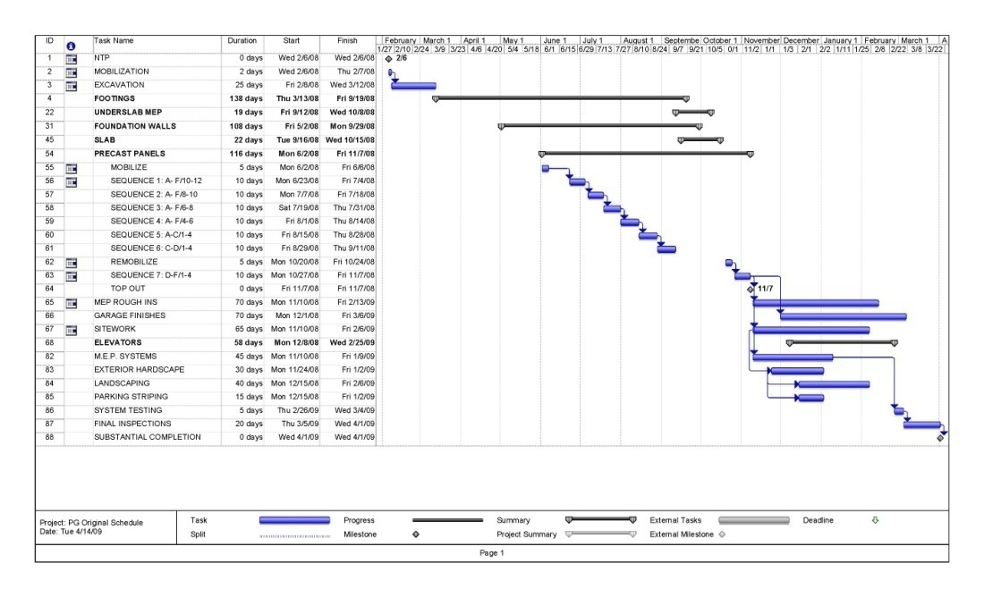
Actual Construction Sequence
February 6, 2008 – April 1, 2009; 420 days
Constructed in 2 phases
46 day gap in precast member erection
Notes:
Started erecting members in north end of garage and worked south
Had crane in basement of garage
This was done because close proximity to other buildings and the sedimentation pond; also because of the heavy members it would have been cost prohibitive to use a crane that set all the members from outside the building perimeter
Part of delay was to build remaining part of foundation, but part of it was because the foundation had to fully cure before members were allowed to be set

Slide 43
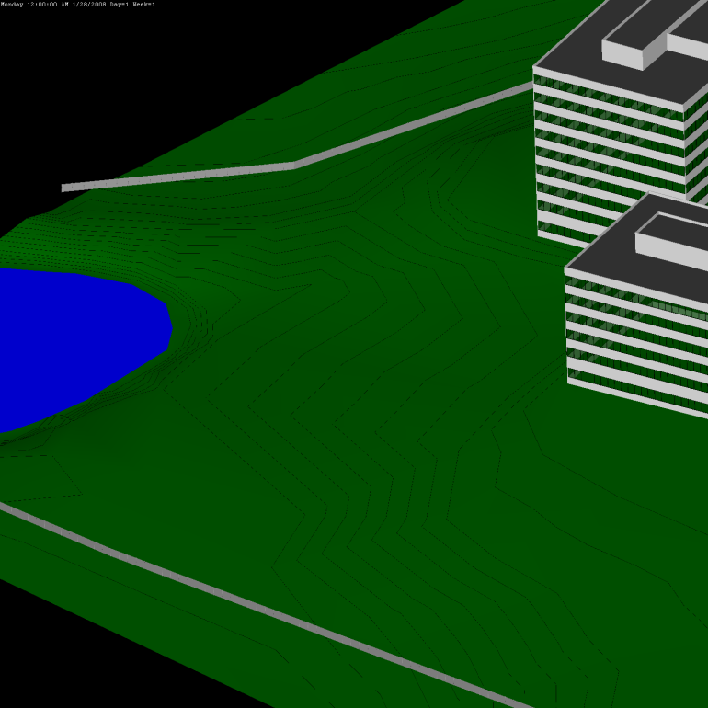
Actual Construction Sequence
February 6, 2008 – April 1, 2009; 420 days
Constructed in 2 phases
46 day gap in precast member erection
Notes:
Started erecting members in north end of garage and worked south
Had crane in basement of garage
This was done because close proximity to other buildings and the sedimentation pond; also because of the heavy members it would have been cost prohibitive to use a crane that set all the members from outside the building perimeter
Foundation had to fully cure before members were allowed to be set

Slide 44
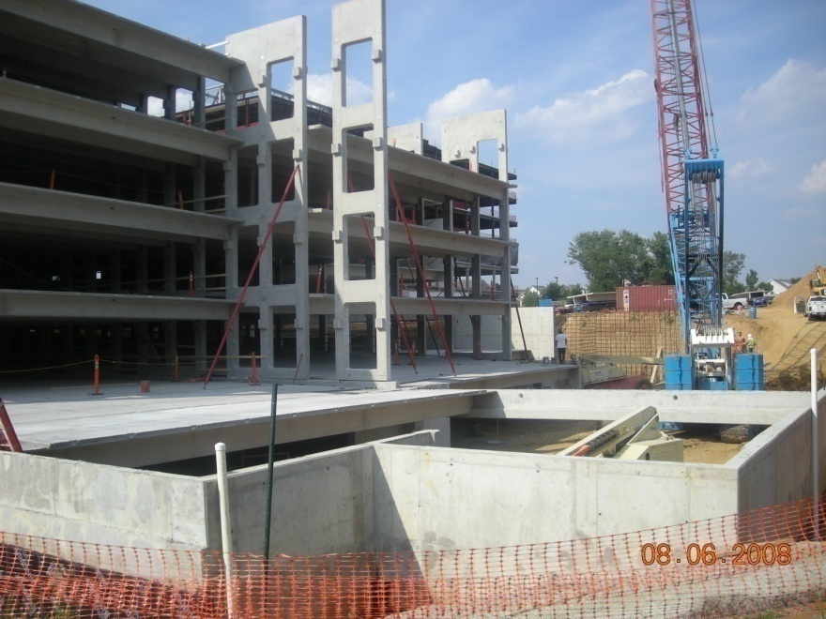
Actual Construction Sequence
No remobilization fees were paid to the Precast Erectors, Inc. because only 1 mobilization charge was stated in contract with Clark Construction
Precast Erectors PM estimated second mobilization costs were $70,000
Precast Erectors absorbed second mobilization costs

Slide 45
Proposed Construction Sequence
Erect majority of building in same manner as the actual sequence except leave out south non-load bearing foundation wall instead of corner
Erect members from inside the building
Move crane from basement to outside foundation wall through opening in wall and erect last sequence
Notes:
Two reasons for t

Slide 46
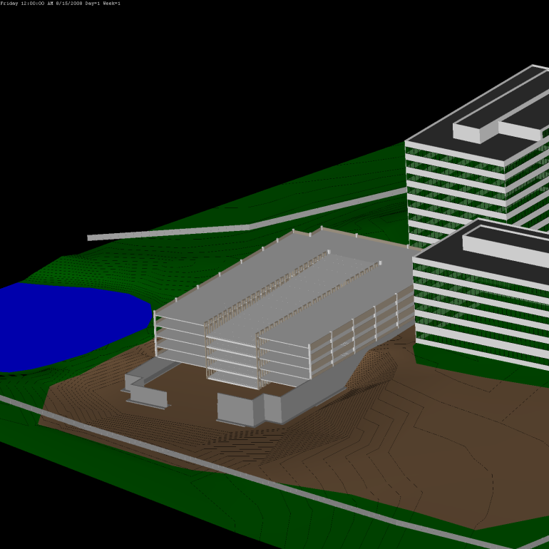
Proposed Construction Sequence
Erect majority of building in same manner as the actual sequence except leave out south non-load bearing foundation wall instead of corner
Erect members from inside the building
Move crane from basement to outside foundation wall through opening in wall and erect last sequence
Notes:
Two reasons for t

Slide 47
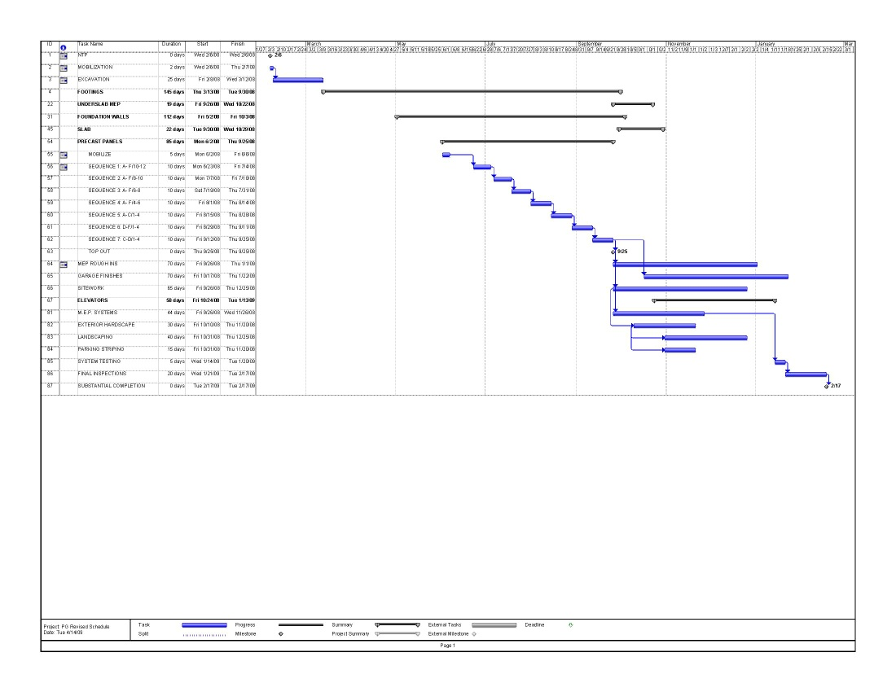
Proposed Construction Sequence
Erect majority of building in same manner as the actual sequence except leave out south non-load bearing foundation wall instead of corner
Erect members from inside the building
Move crane from basement to outside foundation wall through opening in wall and erect last sequence
February 6, 2008-February 17, 2009; 377 days
Saves 43 days in construction duration
Notes:
Allows project to be completed earlier
Minimizes exposure for accidents for longer durations of people on project
Only have to erect crane once
Allows sitework to be completed by December, versus February with actual sequence

Slide 48
Cost Impacts
GCs are reduced
Precast Erectors would save $70,000 for the second mobilization costs
Project cost is not affected

Slide 49
Conclusion
Proposed sequence saves 43 days in construction duration
Saves Precast Erectors $70,000 in second mobilization costs
Does not reduce cost to owner
Allows Clark Construction to better manage risks
Recommendation
Use proposed sequence to reduce construction duration, minimize risks on project, allow site work to finish earlier, and save Precast Erectors second mobilization costs
Would make project more of a success for everyone involved

Slide 50
Conclusion
Chilled beams are a new HVAC technology which has the potential to drastically improve a building’s energy efficiency
Chilled beams can be implemented at RTC BII for $75,056 with payback period less than 1 year and no schedule impact
Wire upsizing has the potential to save energy
Implement in areas with constant high loads
Proposed sequence for the parking garage saves 43 days on the schedule; costs are not reduced
Recommendation
All three analysis topics should be used for project

Slide 51
Acknowledgements
Penn State Architectural Engineering Faculty
Clark Construction
Jim Martinoski
Erin Gardner
John Neuenschwander
Syska Hennessey Group
Alla Ketsnelson
WSP Flack + Kurtz
Albert Flaherty
Tindall Corporation
Jeff Lepard
Friends and Family
Questions?

